Slide 1
Real-World Reinforcement Learning: Challenges and Opportunities
Enes Bilgin Sr. AI Engineer | Microsoft Autonomous Systems RL Zurich & Pie & AI
January 12, 2021
github.com/ebilgin/talks

Slide 2


WHERE WE ARE at WITH RL

Slide 3
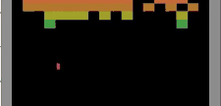
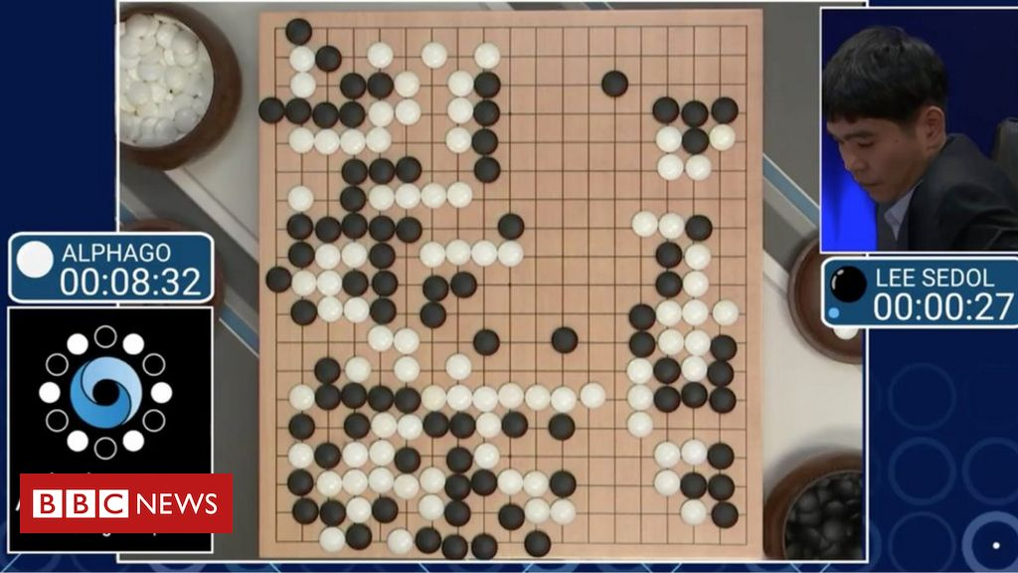
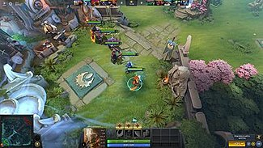

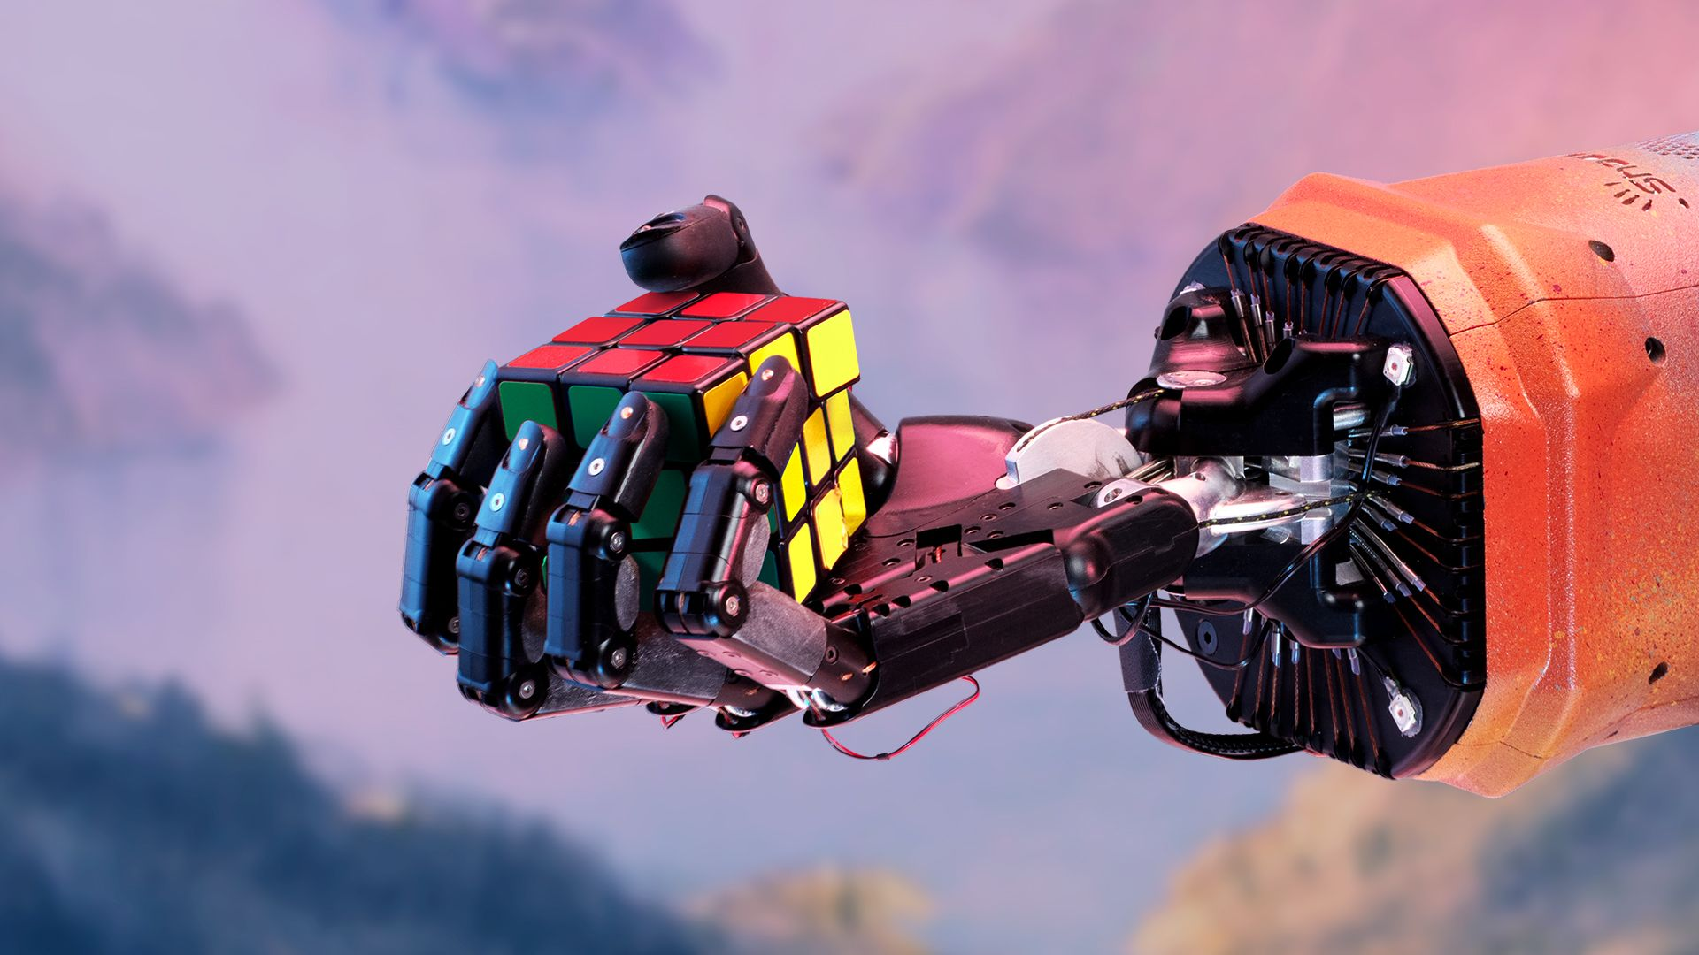
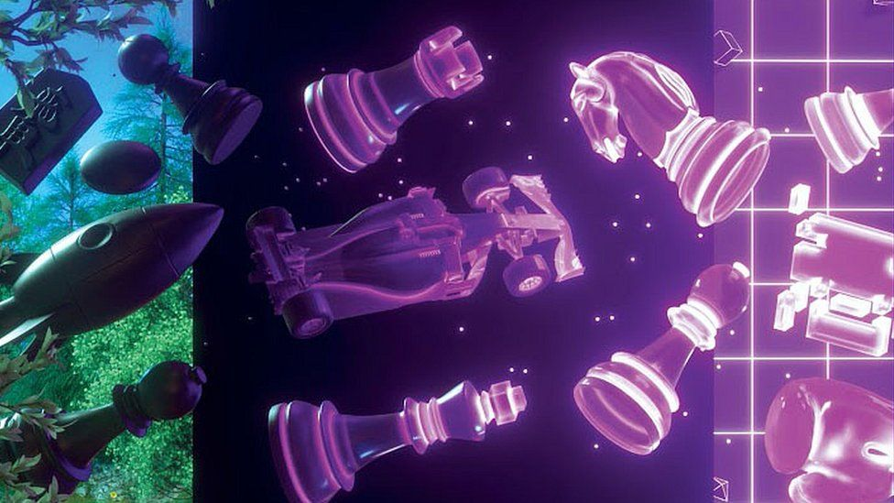
RL Success STORIES
ATARI
ALPHAGO
DOTA 2
STARCRAFT II
ROBOT HAND
MuZERO

Slide 4
The GRAND PROMISE OF RL
“Near-optimal sequential decision-making under uncertainty to maximize some long-term benefit.”
A lot of research is going on to bring RL up to its potential.
Yet, real-life success stories in RL are still rarity

Slide 5

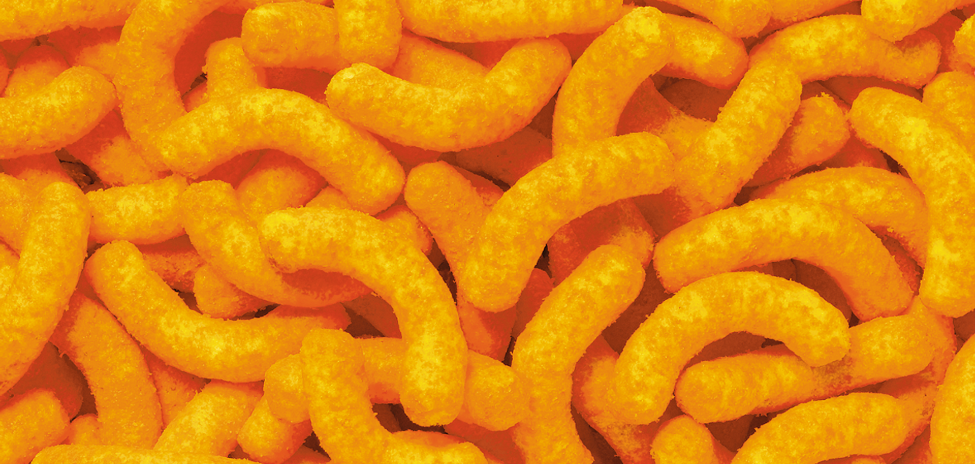

REAL-WORLD RL SUCCESS STORIES
NETFLIX
PERSONALIZATION
MICROSOFT & PEPSICO
MANUFACTURING
LOON & GOOGLE AI
NAVIGATION
There are major challenges for RL to make its way to mainstream.
This will likely change soon.

Slide 6
Real-World RL Challenges & OPPORTUNITIES
This talk focuses on
Some of the key challenges in real-world RL
Some promising directions to overcome those
Disclaimer:
A lot of the talking points are from my experience at Microsoft’s Project Bonsai
I am here at my own capacity, and these are my personal views
If interested, visit: https://www.microsoft.com/en-us/ai/autonomous-systems

Slide 7
CHALLENGE: SAMPLE EFFICIENCY

Slide 8
Challenge: sample efficiency
Algorithm comparisons on Atari
Resources to train a Dota 2 agent
The hunger for data in RL is much worse than that of deep supervised learning

Slide 9


RL LOOP
Actions based on observations
Uncertain environment
Sequential decision-making
Maximize long-term benefit
Generate experience with random actions
Learn from experience
Similar to human/animal learning…
(Well, not that much)
Action
Observation
Reward

Slide 10
How humans actually learn
Like an RL agent:
We explore different decisions in various circumstances
We exploit most of the time
Yet, this is not the whole of the story.
We are not deserted on earth as lonely agents wandering around to discover stuff.

Slide 11

Education, education, education…
We spent most of our time learning from experts, through formal and informal channels
An entire education system is designed to train us starting with fundamentals up to advanced levels
And this is efficient (it would suck to constantly reinvent the wheel)
Why not educate machines similarly?
Image credit: https://xpertcube.com/modern-education-system/

Slide 12
APPROACH: MACHINE TEACHING

Slide 13
MACHINE TEACHING
Machine Teaching is a paradigm that suggests transferring subject matter expertise in humans to machine learning models to facilitate training.

Slide 14


MACHINE TEACHING

Slide 15
divide THE task into concepts
Training a basketball playing agent over
Entire game, vs.
Smaller concepts
Dribbling
Passing
Shooting…
Also train/use a selector concept to switch

Slide 16
divide THE task into concepts
This facilitates learning since:
Smaller tasks are easier to learn
Credit assignment gets easier
Training budget spent better by focusing on weak skills

Slide 17
divide THE task into concepts
It is machine teacher’s duty to
Design the concepts
Define reward function for each concept
Train/code rules to switch between concepts

Slide 18

Use a curriculum
Parametrize the concept difficulty
E.g. number of players to dribble through
Gradually increase the difficulty
Transition to a next lesson if “success”
Fall back to a previous lesson if “failure”

Slide 19
Use a curriculum
It’s the machine teacher’s duty to:
Define parametrization / lessons
Define success and failure criteria
Automated approaches:
Automatic Domain Randomization
Absolute Learning Progress – Gaussian Mixture Models

Slide 20

CONSTRAIN THE EXPLORATION
Limit the available actions with respect to the observation (action masking).
“Don’t run forward after losing the ball.”
Don’t let the agent explore states known to be “bad” (e.g., through use of terminal conditions).
“Don’t bunch together in the offense.”

Slide 21

Provide feedback
Engineer the reward function (at your own risk) to incentivize “good” behavior:
Reward successfully completed passes.
Train auxiliary models to classify behavior as “good” or “bad”
Compare and rank two dribbling experiences

Slide 22
MACHINE TEACHING
Machine Teaching involves creating the tools to allow non-ML experts to convey their experience intuitively to RL agents.
Like how school teachers are not neuroscientists, but leveraging learning techniques developed by neuroscientist, machine teachers don’t have to be machine learning scientists.
Example: Defining/shaping the reward function automatically based on the user feedback provided in natural language / interactive mechanisms.
This approach can unlock the potential in RL.

Slide 23
Criticism
“This is feature engineering on steroids!”
Yes, in the absence of auto ML/MT capabilities. Need tools to automate/facilitate MT.
SMEs know so much about their business problem. Why not leverage that knowledge?
MT makes training much more efficient, and feasible in some cases: Invaluable for fast iteration.
“Aren’t we inserting a bias to the learning?”
Exactly. No need to discover genius strategies for a robot arm task as opposed to Go.
“Isn’t this at odds with approaches like MuZero?”
They are complementary: Automate every-day business/industry tasks rather than solving AGI.

Slide 24
CHALLENGE: NEED FOR SIMULATION

Slide 25
Need for Simulation
Among all processes in industry that can be automated via RL, an extremely tiny fraction of them have associated simulation models
When available, simulation models are often not suitable for RL:
Low fidelity – makes it hard to transfer trained models to real world.
Too slow – takes long time to collect enough samples.
Domain specific software – hard to integrate with RL libraries.
Constrained by licensing – very expensive to parallelize for experience collection.
No capabilities of revealing observations, resetting, domain randomization…

Slide 26
Approaches: OFFLINE RL Better sim integration

Slide 27
Offline reinforcement learning
Simulation models are a rarity, but data / process logs are in abundance.
Offline RL learns directly from data produced by a non-RL controller
The policy does not interact with the environment during training.
Mostly relies on importance sampling to evaluate a new policy
It is posed to lead to a breakthrough to bring RL to real-world problems.

Slide 28
Better sim integration
Offline RL will always have limited capability due to lack of exploration / interaction with the environment.
Companies will focus more and more on creating simulations / digital twins.
This will be accompanied by better integrations between simulation software and RL tools / platforms.

Slide 29
CHALLENGE: SIM-TO-REAL GAP

Slide 30
SIM-TO-REAL GAP
Agents trained in simulation tend to overfit to quircks of the simulation and fail in real world.
Main approaches to overcome sim-to-real gap:
Domain randomization / data augmentation
Increases the training budget
For the sake of robustness, the policy performance in common environment configurations may deteriorate
Meta-RL
Although very promising, not as powerful as domain randomization

Slide 31
APPROACH: DESIGN THE REAL WORLD

Slide 32
Designing the environment
The generalization challenge for a self-driving car and self-driving forklift is not the same
In many industrial applications, there is a room to influence the design of the environment for better agent performance.
An example of this is to create “unadversarial objects” that are easy to be perceived by the agent.
Hadi Salman et al. 2020 - Unadversarial Examples: Designing Objects for Robust Vision

Slide 33
Unadversarial objects

Slide 34
Unadversarial objects

Slide 35

Unadversarial objects
Computer vision models notoriously suffer from adversarial perturbations:
This is done my maximizing the model loss over via trainable perturbation:
$$δ_{adversarial}=\arg{\max_{δ∈Δ}{L(}θ;x+δ,y)}$$
Unadversarial examples are created by minimizing this loss.
RL agents can benefit from such modifications in the environment.

Slide 36
Other major challenges

Slide 37
More challenges and more opportunities
Creating a (multi-objective) reward function could be very painful.
Inverse reinforcement learning could help with this.
RL policies are risky to deploy in safety-critical environments unlike classical controllers that come with theoretical guarantees.
There are a lot of research going on in safe RL.
High-dimensional action spaces are hard to deal with.
Action embeddings (used in OpenAI Five) are quite promising

Slide 38
Real-World RL Challenges
Recommended on the topic:
Alex Irpan: “Deep Reinforcement Learning Doesn't Work Yet”
Dulac-Arnold et al: “Challenges of Real-World Reinforcement Learning”
Dulac-Arnold et al: “An empirical investigation of the challenges of real-world reinforcement learning”

Slide 39
THANK YOU

Slide 40
therlbook.com

Slide 41
ADDITIONAL DISCUSSION

Slide 42
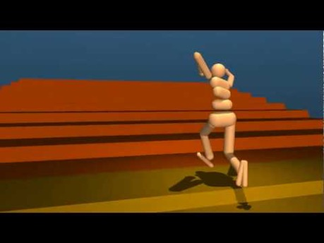
Challenge: DESIGNING reward function
RL algorithms care about maximizing the total reward you defined, not what you intended it to do.
Emergence of Locomotion Behaviours in Rich Environments

Slide 43
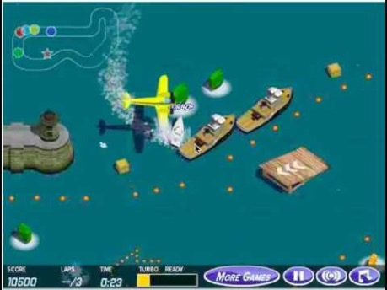
Challenge: DESIGNING reward function
RL algorithms are great at finding loopholes in your reward design.
CoastRunners
Faulty Reward Functions
OpenAI Blog

Slide 44
REWARD FUNCTION FAILURE ANECDOTES
Source: Alex Irpan – Deep RL does not work yet

Slide 45
increasing sample efficiency
Model-based reinforcement learning
Learn the environment dynamics, then try to figure out a policy
Meta-learning
Humans don’t learn every task from scratch (if a baby knows how to grab a toy, learning how to grab a plate is not that difficult)
Meta-learning involve training models for general tasks and then transfer them to new tasks with fewer training data
Machine Teaching
Inject the expertise in humans to the training process

Slide 46
Learning without a reward
Curiosity-driven reinforcement learning
Reward the agent based on the novelty of scenes it encounters
No external rewards
Inverse reinforcement learning
Figure out rewards from demonstrations

